Slide 1

Convolution Processing Unit
Featuring Adaptive Precision using Dynamic Reconfiguration
WF-IoT 2021 Paper
David Cain, Omar Eldash, Kasem Khalil, Magdy Bayoumi
Presented by David Cain

Slide 2
Overview
Introduction
Computer Vision
Traditional IoT CNN Models
Reconfigurable Hardware
Dynamic Partial Reconfiguration
Related Work
Proposed Convolution Processing Element
Hardware Implementation & Comparisons
Conclusions
Q&A
1

Slide 3

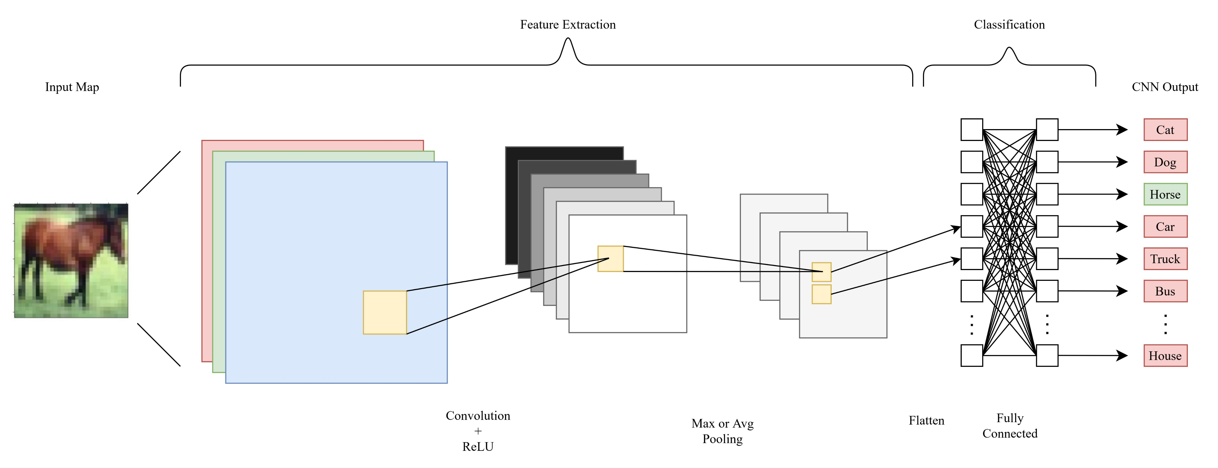
Computer vision is a deep learning application enabling object detection / classification
Unique edge devices with image and video data are being created for these applications in mind
The CNNs used are often complex and too computationally bulky for IoT edge devices
Computer Vision
2

Slide 4
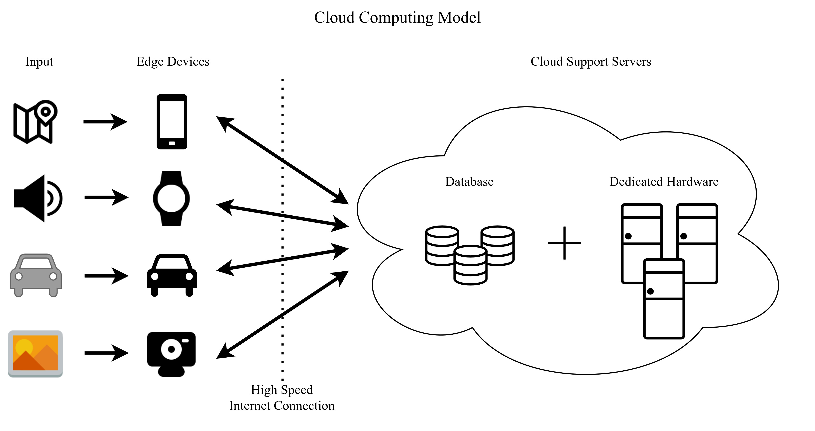
With traditional cloud computing models, edge devices are “dumb” data aggregators
Cloud servers perform CNN processes
Dedicated server hardware has much greater processing capabilities and relaxed power constraints compared to edge devices
High connectivity required
Traditional IoT CNN Models
3

Slide 5
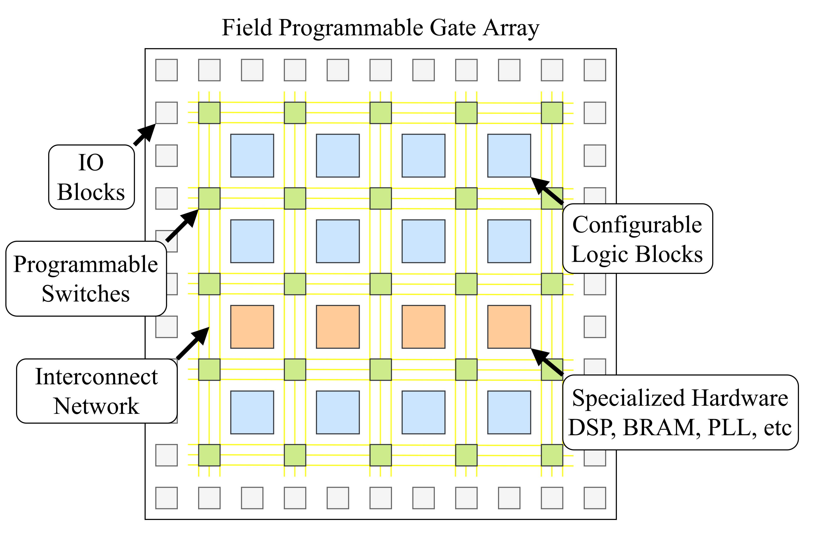
Due to low development overhead, FPGAs are being investigated for accelerating CNN process at the edge devices
Reconfigurable computing devices change behavior or functionality at the hardware logic level
FPGAs are a member of reconfigurable hardware and offer Dynamic Partial Reconfiguration
Reconfigurable Hardware
4

Slide 6
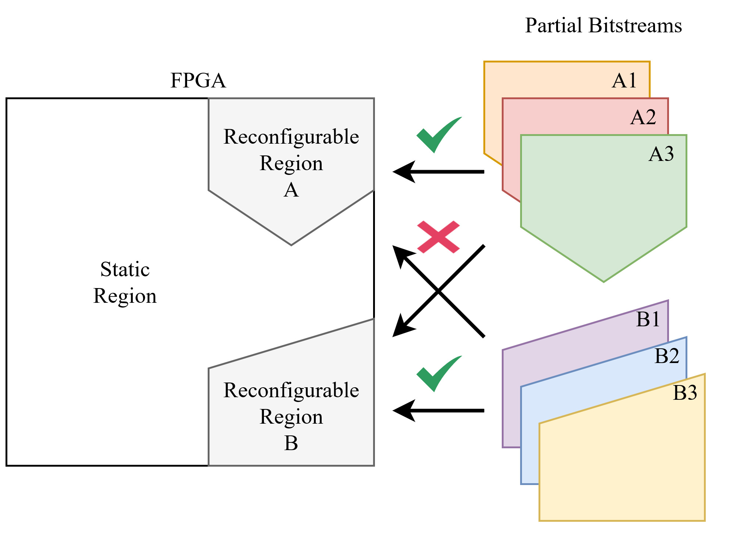
DPR allows the device to partially reconfigure while the rest of the system remains unchanged
Offline Reconfiguration
Online Reconfiguration
Modern DPR design flows use reconfigurable regions with partition definitions to be loaded after full configuration
The partial bitstream file size directly correlates with the reconfigurable region size
Dynamic Partial Reconfiguration
5

Slide 7
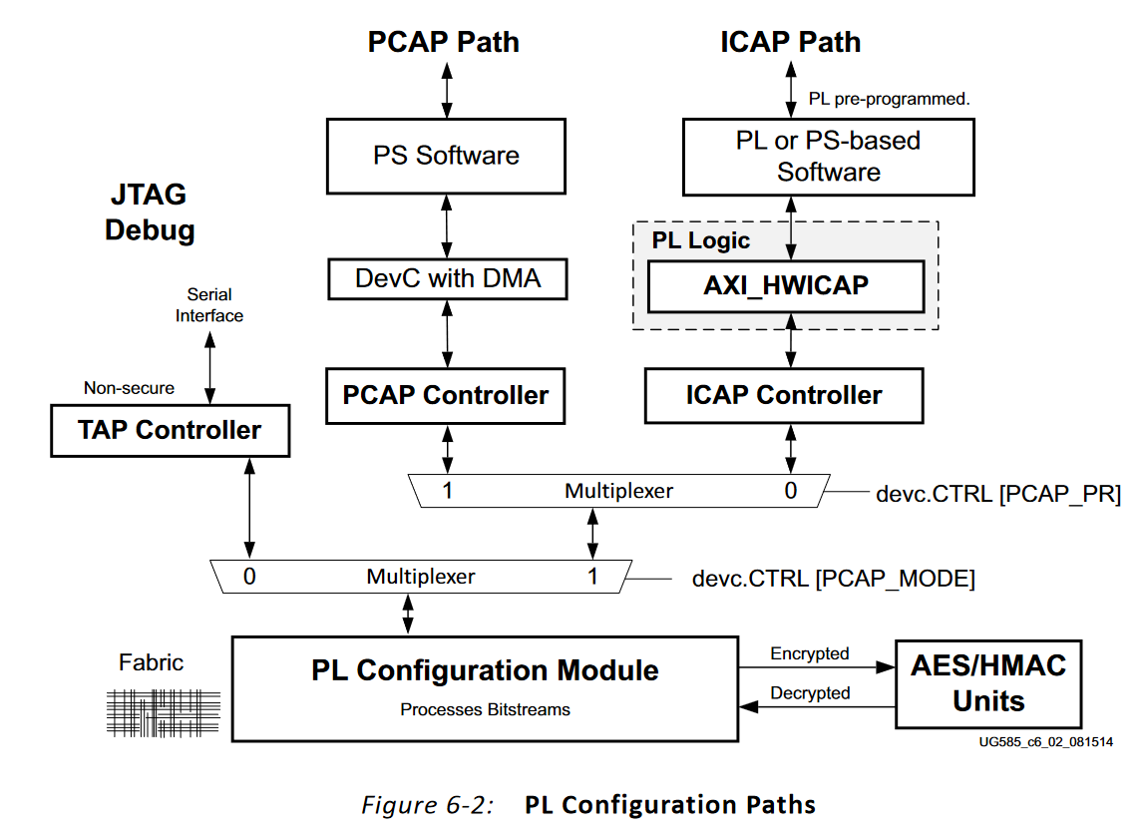
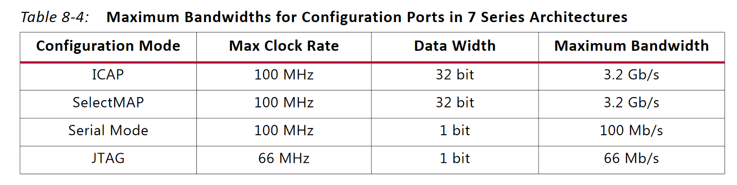
FPGA has several ways to programmed on boot that vary with device family
The Zynq device used in implementation allows programming over Serial, JTAG, ICAP, and PCAP
The port bandwidth varies drastically
Ref: Xilinx UG585 Zynq-7000 SoC Technical Reference Manual
Ref: Xilinx UG909 (v2018.1) Partial Reconfiguration
Dynamic Partial Reconfiguration
6

Slide 8
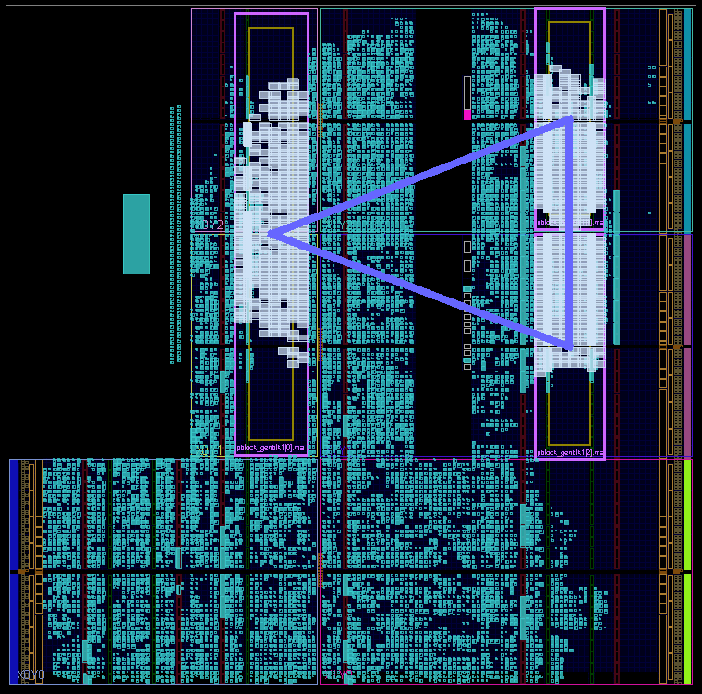
Reconfigurable regions are manually mapped to the FPGA floorplan during Synthesis
If the partition definitions need special elements like DSP, the region must be mapped to include this
3 channel convolution processor with RR mapped to FPGA floorplan
Reconfigurable Regions
Dynamic Partial Reconfiguration
7

Slide 9
Related Work
Introduction
Computer Vision
Traditional IoT CNN Models
Reconfigurable Hardware
Dynamic Partial Reconfiguration
Related Work
Proposed Convolution Processing Element
Hardware Implementation & Comparisons
Conclusions
Q&A
8

Slide 10
FINN and DNNWeaver two frameworks for generating fully synthesized CNN models to deploy on an FPGA target
- Hardware Utilization
FINN is developed by a Xilinx research group and specializes in low latency streaming applications
- HLS
DNNWeaver is an open-source framework that employs groups universal processing elements and a state machine to assign data to one layer of the CNN at a time
- Caffe
FINN Ref: https://xilinx.github.io/finn/about.html
DNNWeaver Reg: http://dnnweaver.org/
Related Work
9

Slide 11
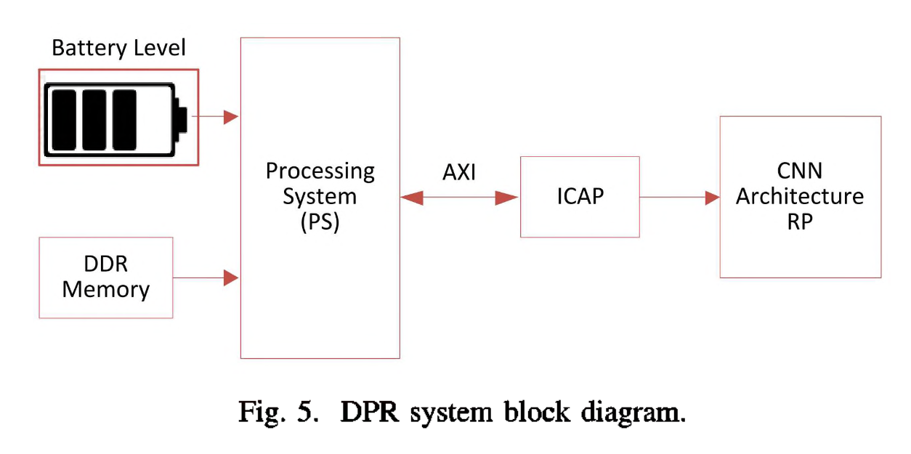
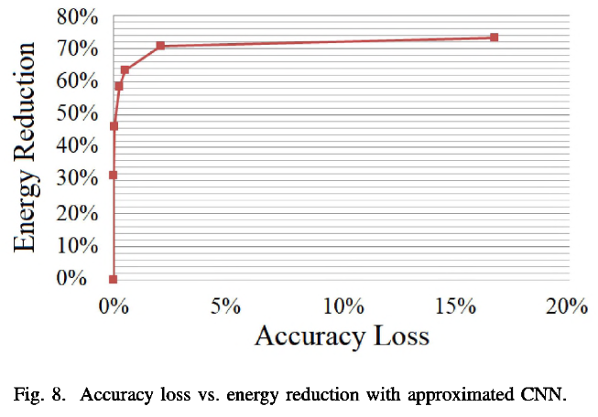
Ref: E. Youssef, H. A. Elsemary, M. A. El-Moursy, A. Khattab and H. Mostafa, "Energy Adaptive Convolution Neural Network Using Dynamic Partial Reconfiguration," 2020 IEEE 63rd International Midwest Symposium on Circuits and Systems (MWSCAS), Springfield, MA, USA, 2020, pp. 325-328, doi: 10.1109/MWSCAS48704.2020.9184640.
Youssef et. al developed an MNIST CNN architecture to support DPR for reducing bit precision which enables lower dynamic power consumption
The energy consumption of this model at 16 bits was shown to be 11.25μJ per image and at 5 bits, 3.02 μJ per image while retaining 81.74% accuracy
Related Work
10

Slide 12
Proposed Convolution Processing Element
Introduction
Computer Vision
Traditional IoT CNN Models
Reconfigurable Hardware
Dynamic Partial Reconfiguration
Related Work
Proposed Convolution Processing Element
Hardware Implementation & Comparisons
Conclusions
Q&A
11

Slide 13
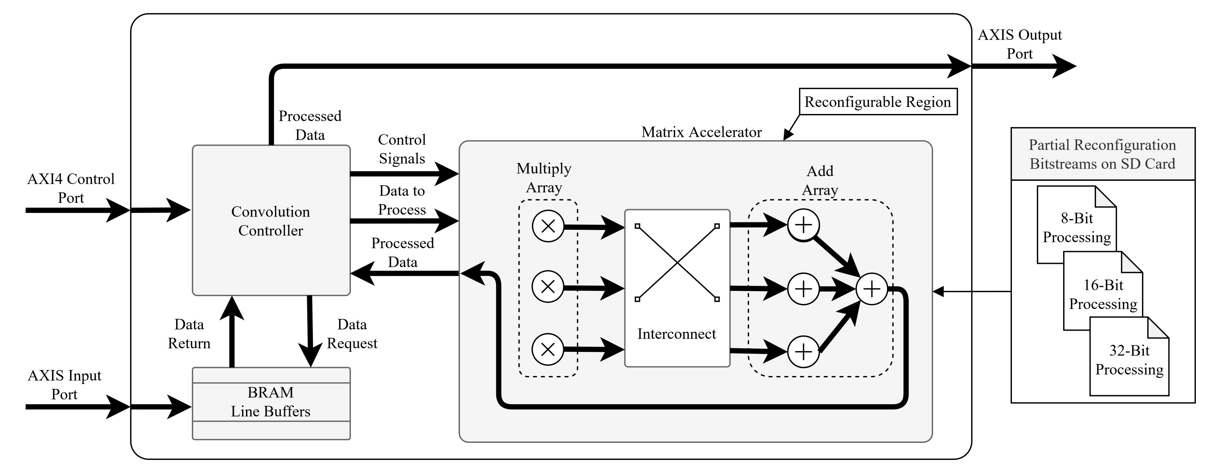
The proposed Convolution Processing Element utilizes DPR at a processing element level whereas traditional methods must either fully reconfigure or use DPR at a pipeline level
Proposed Convolution Processing Element
12

Slide 14
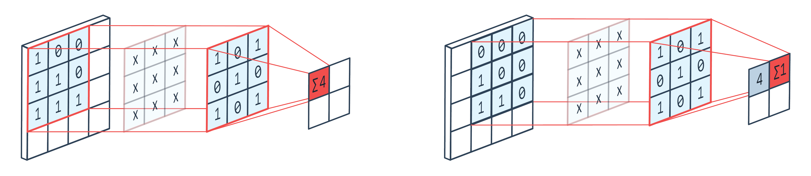
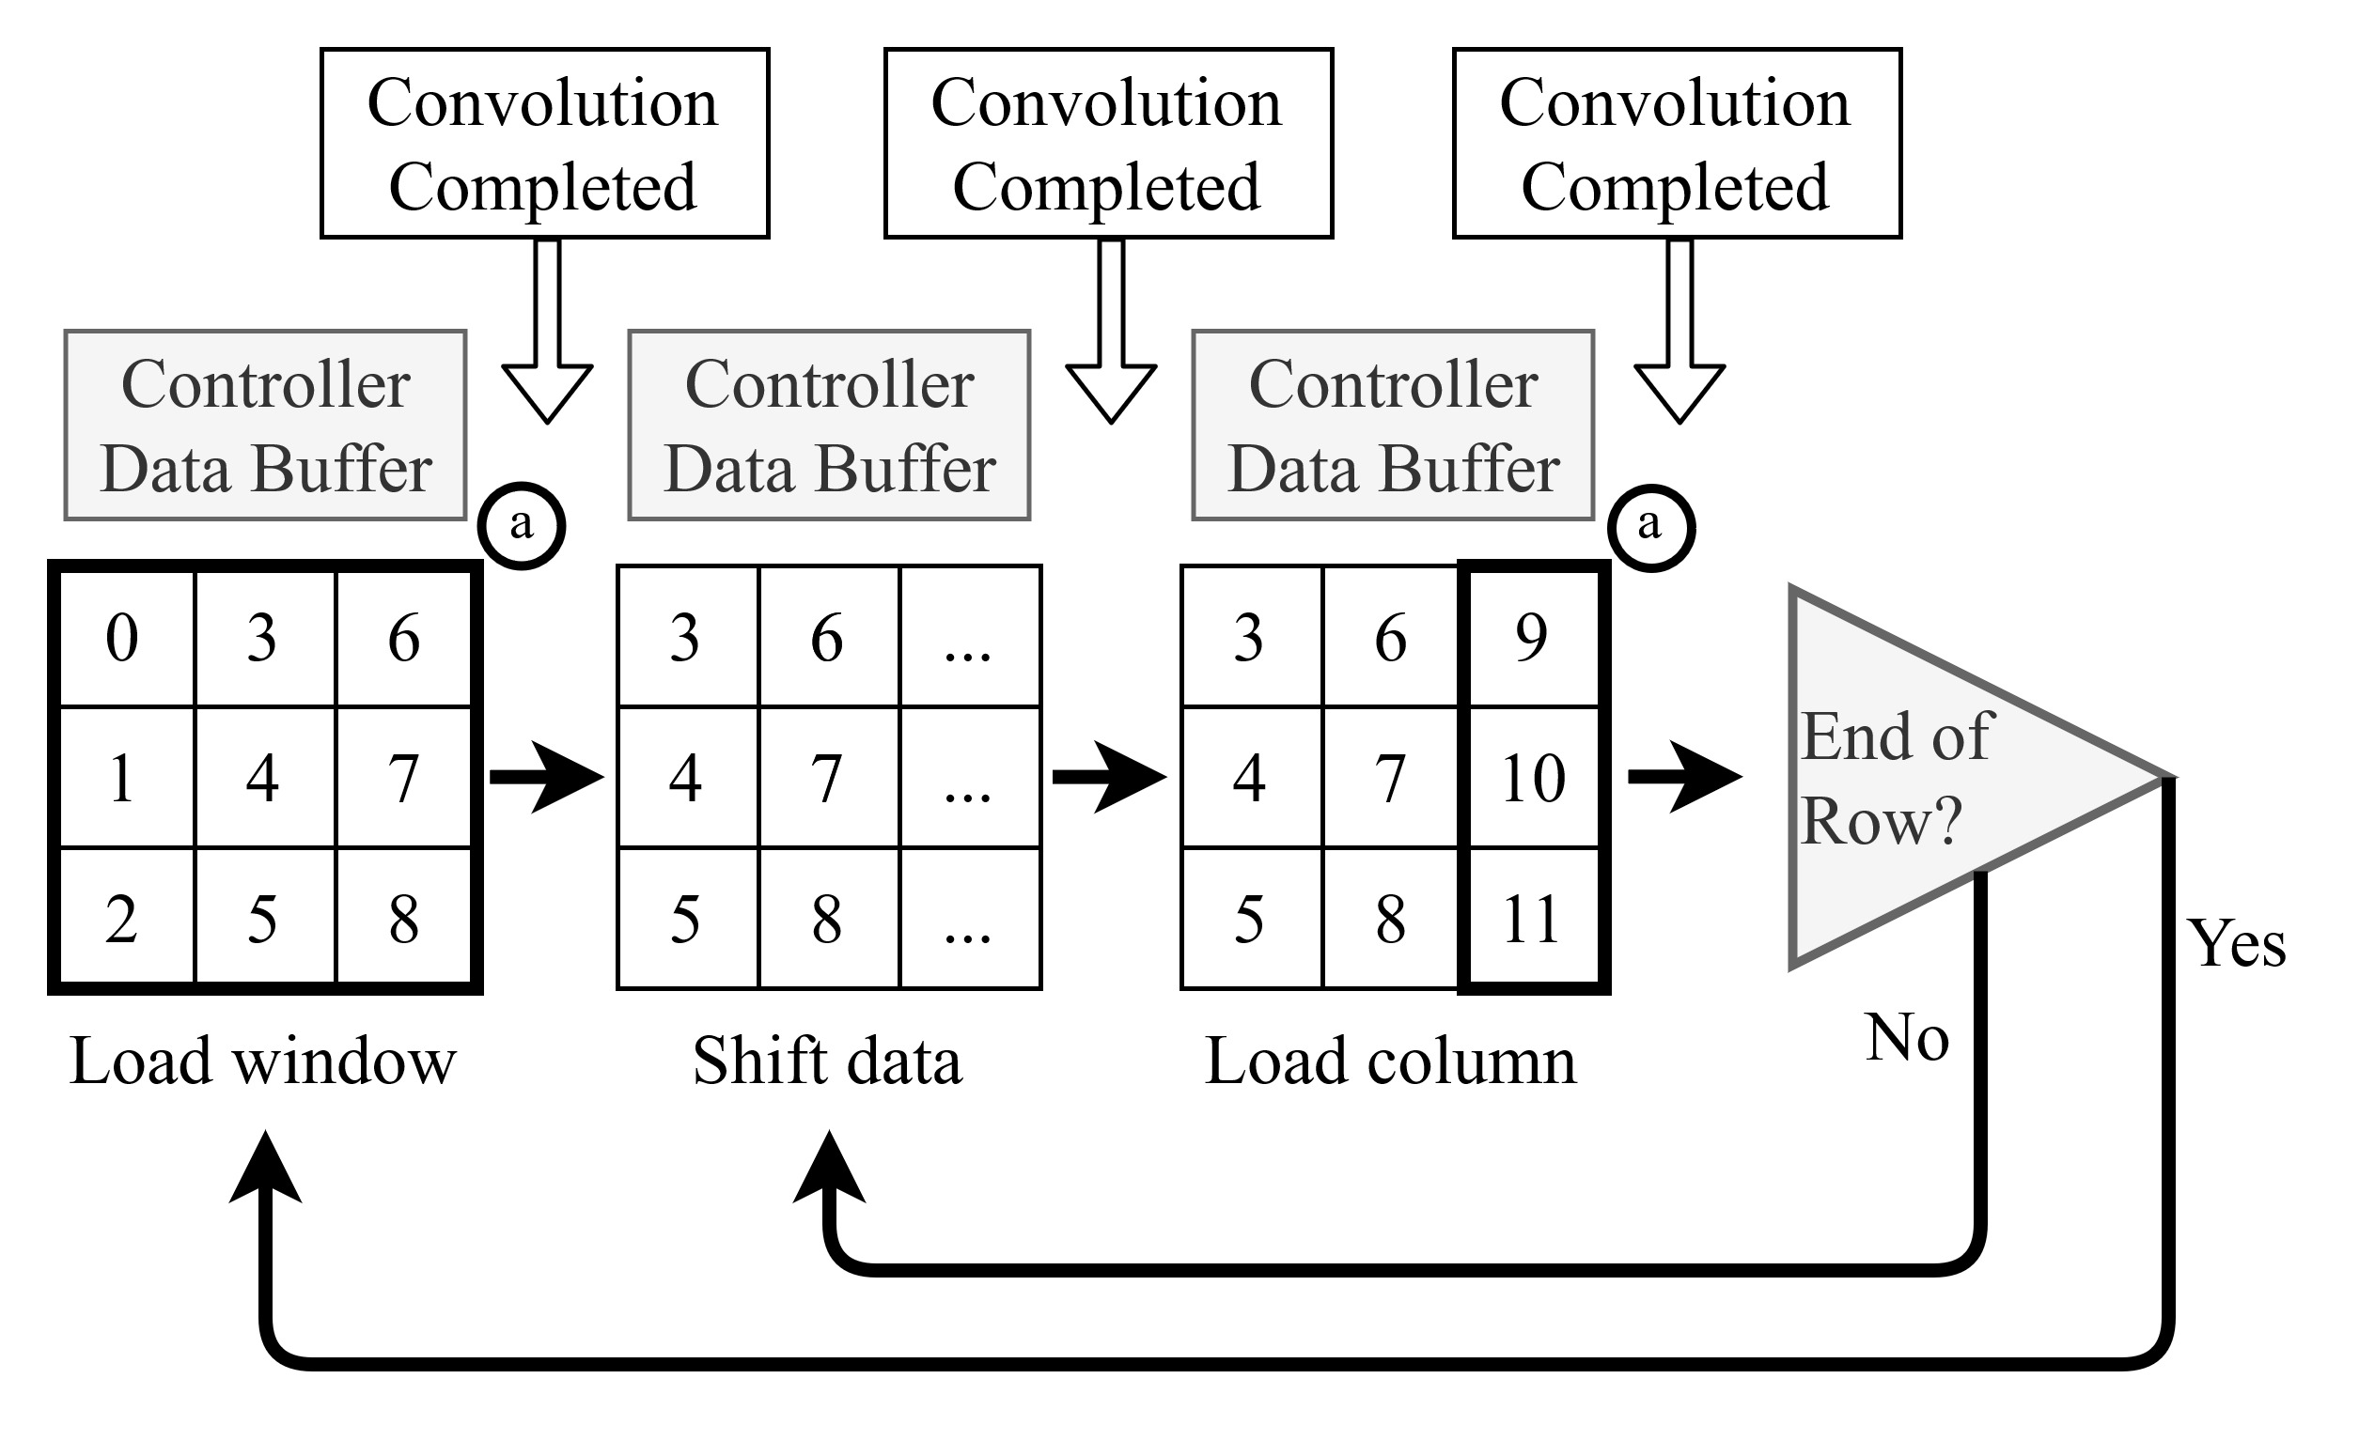
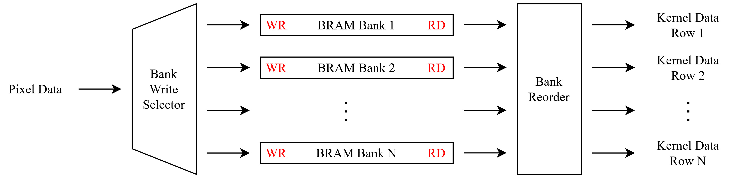
The convolution controller handles the data stream with an internal state machine
For a kernel of size N, the line buffers temporarily store N rows of input map as each convolution requires NxN data points from N rows and N columns
Line buffers are implemented to infer into BRAM as to not waste available device logic
Proposed Convolution Processing Element
13

Slide 15
Hardware Implementation & Comparisons
Introduction
Computer Vision
Traditional IoT CNN Models
Reconfigurable Hardware
Dynamic Partial Reconfiguration
Related Work
Proposed Convolution Processing Element
Hardware Implementation & Comparisons
Conclusions
Q&A
14

Slide 16
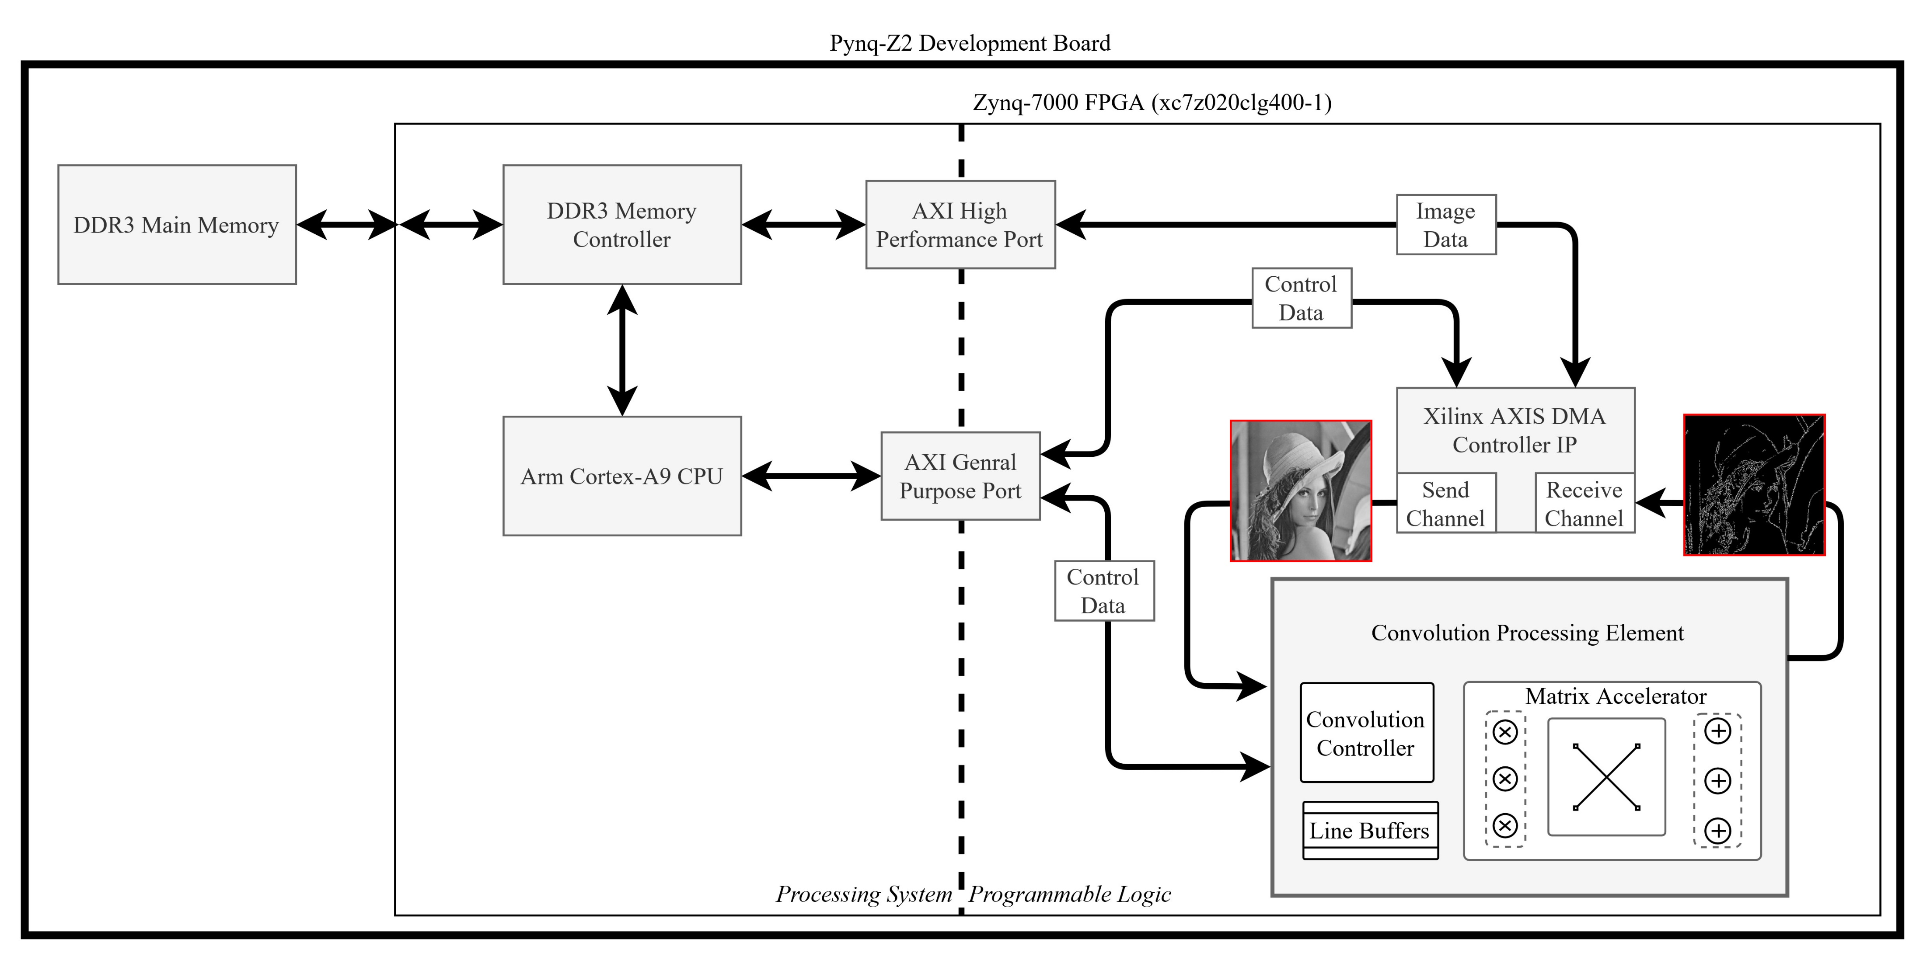
Implemented on a Pynq-Z2 which features a Zynq-7000 FPGA
Reconfigurable between 8-, 16-, and 32-bit precision with 1 or 3 processing channels
Benchmarked using PYNQ Python Jupyter Notebook and the Vitis C environment
Hardware Implementation & Comparisons
15

Slide 17
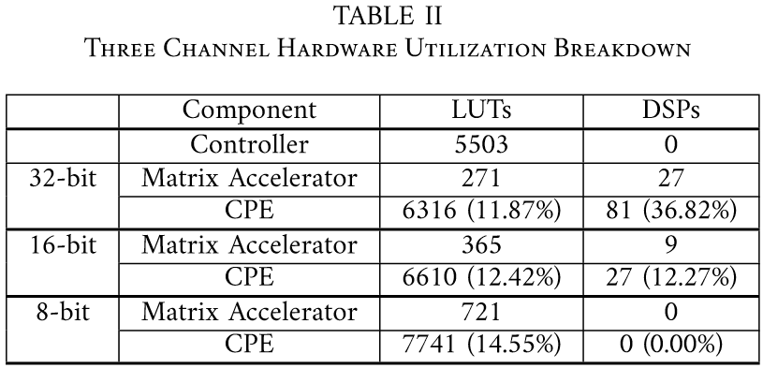
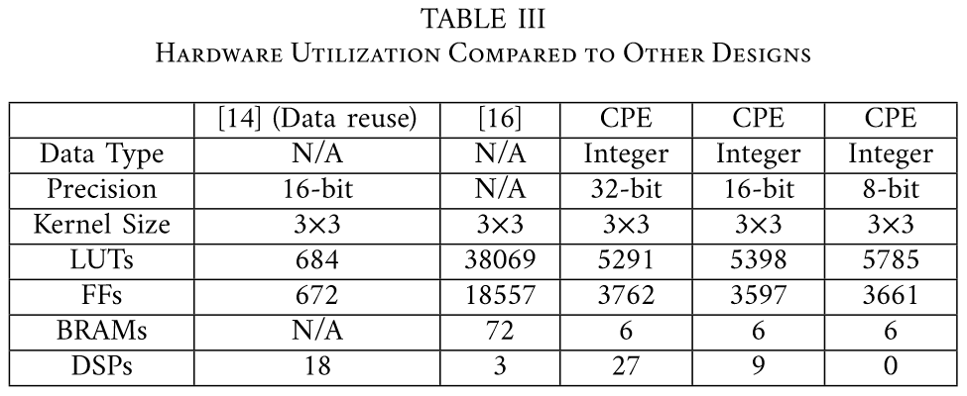
The proposed 3-channel CPE hardware utilization was compared against other designs
At the 32-bit configuration, DSP utilization reaches 36% of total available for the device
Rupani et. al use a design which buffers the full image which causes high BRAM utilization
Hardware Implementation & Comparisons
16

Slide 18
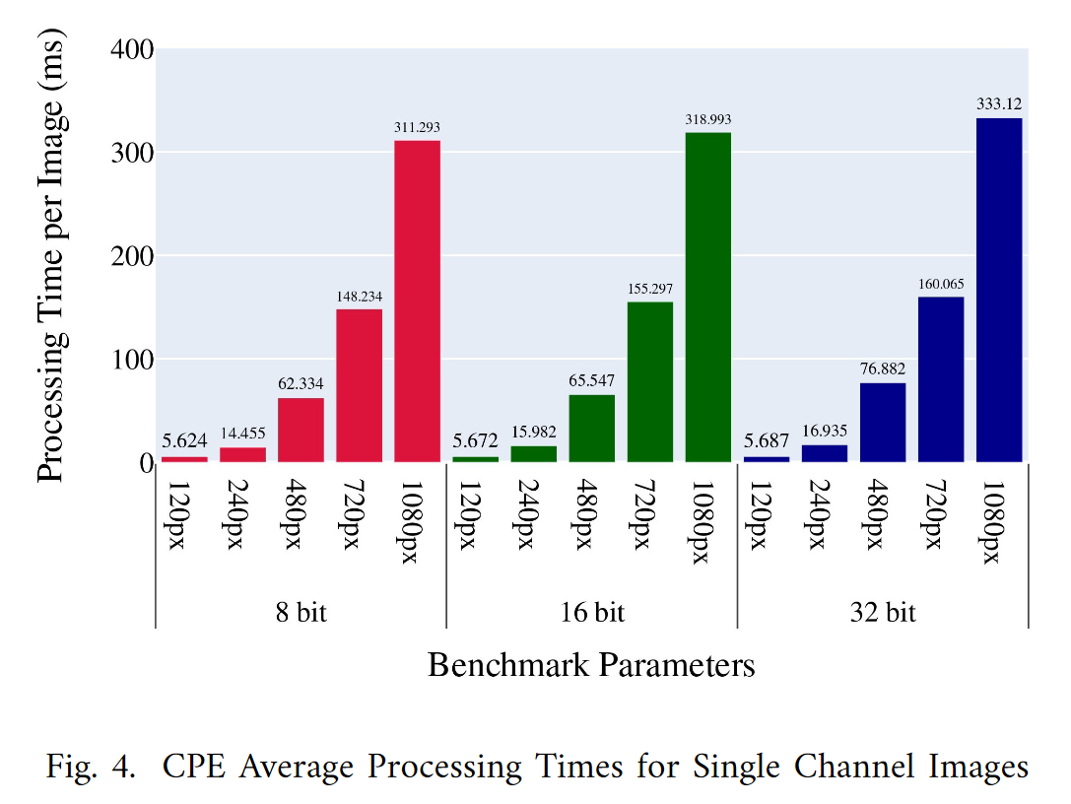
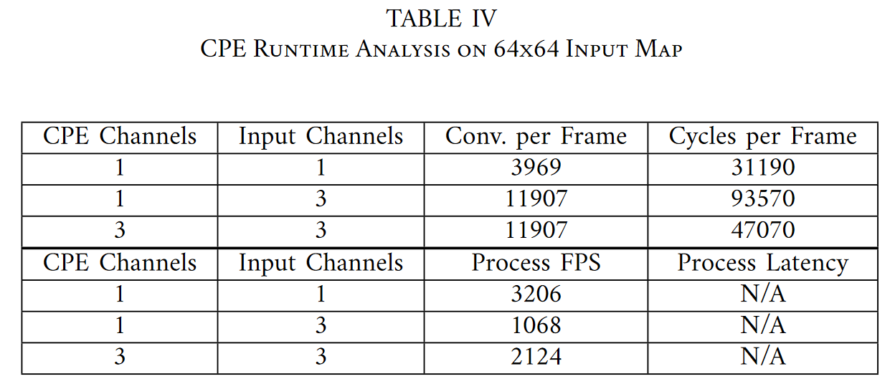
When testing with Jupyter Notebooks (Left), reconfiguration was completed using JTAG
Benchmarking was moved to Vitis (Right) which enabled use of the ICAP for reconfiguration
Hardware Implementation & Comparisons
17

Slide 19
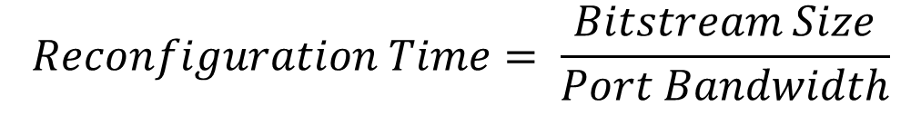
$$Reconfiguration Time= \frac{Bitstream Size}{Port Bandwidth}$$
(Traditional)
Full Reconfiguration
Using JTAG
Partial Reconfiguration
Using JTAG
Partial Reconfiguration
Using ICAP
Bitstream Size:
32,364,512 b
Port bandwidth:
66 Mb/s
Reconfiguration Time:
490.371 ms
Bitstream Size:
1,766,976 b
Port bandwidth:
66 Mb/s
Reconfiguration Time:
26.772 ms
Bitstream Size:
1,766,976 b
Port bandwidth:
3.2 Gb/s
Reconfiguration Time:
0.552 ms
As traditional methods would reconfigure the full device via JTAG,
using DPR at a processing element level reduces configuration time by 800x
Hardware Implementation & Comparisons
18

Slide 20
Conclusions
With the reduced development time compared to other hardware solutions,
reconfigurable hardware enables power efficient processors to be developed for application specific needs
Reconfigurable hardware offers Dynamic Partial Reconfiguration which greatly suits the constrained hardware systems found in embedded devices
The proposed design provides insight to a design flow which enables system downtime to be reduced if pipelines are to be strategically reconfigured
The proposed design can be elaborated further to reuse hardware for process parallelization at lower precision, etc.

Slide 21

Questions?

Slide 22






Thank You

